Slide 1

Welcome Back!
Mrs. Darby
Grade 2
Class Information

Slide 2

A little about me:
20th year teaching
-I’ve taught Kindergarten, 2nd, 3rd ,4th, and 5th
-Degrees/Endorsements: BS: Liberal Studies, CSUSM, Teaching Credential, CSUSM,ESL Certified
I’ve lived in Utah for the past 16 years with Mr. Darby, Sarah, Matthew, Roady, Ziva, and Bella

Slide 3
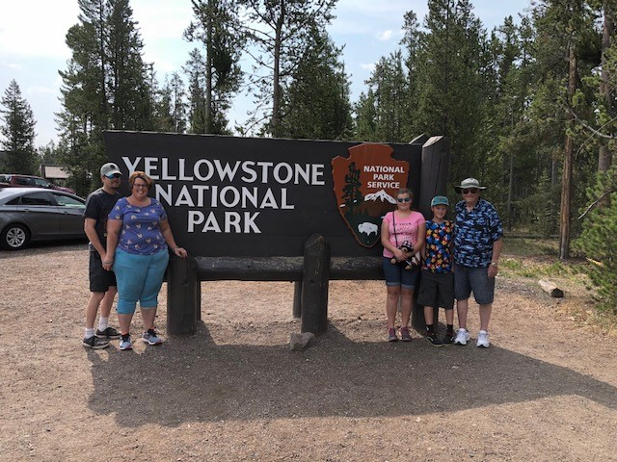
US!

Slide 4
Homework
Please have your student bring their homework folder back on Friday.
It is VERY important for them to read EVERY night for
at least 20 minutes. Reading minutes log will be due every FRIDAY!!!
Homework is not graded however it is great practice.
Math worksheets will be coming home soon. Students only need to do one a night, but still practice concepts done in class and from the math CORE. Please correct your child’s work. If there is something you don’t understand please write me a note on the assignment.

Slide 5

Book Report
Monthly Homework
They are not OPTIONAL
I ask that the children do most of the work
Parents please help but don’t do the work

Slide 6
WAX Museum
At the end of January all of the 2nd grade puts on a Wax Museum. The children read and do research on a famous person (alive or deceased) from either a Biography or Autobiography.
The children come in a costume with a poster about their famous person and come to live when the “button” is pushed.

Slide 7
Math
You can help your student by practicing these concepts in the car and at home. Playing with money, saying the days of the weeks and months, identifying shapes in the environment, practicing time on an analog and digital clocks and making up story problems are a few ideas for helping your student.
**See room calendar or teacher for other ideas**

Slide 8

Reading and Writing

Slide 9
Reading
-READ every night and make sure take-home library books are signed and brought back every day.
-Students need to be fluent in letter names and sounds. Please work on these with your student at home -Sight words are in the homework packet with suggestions for studying.
-Get to know the public library. There are many in Utah!
-Sum-up the book when you are done. What happened in the beginning, middle and end?
(If it is a longer book or chapter book check for understanding every couple of pages at least.)
-Writing helps reading. We will practice at school and you can practice at home or write in a journal.

Slide 10
Reading Comprehension Skills
(We will be focusing on these this year. You can ask your student about them at home when you are reading.)
Visualize
Make Connections
Ask Questions
Clarify
Predict
Sum-up

Slide 11
Behavior
Pink: Outstanding
Purple: Great Job
Blue: Good Choices
Green : Ready to Learn
Yellow: Warning/ Think about it
Orange: Time Out/ Teacher’s Choice
Red: Parent Contact/Loss of Recess/ Stop and Go

Slide 12

I will send out information via Class Dojo, on the Weekly Homework Sheet, or other notes in their homework folders. Please look through your child’s backpack daily.

Slide 13
We want to create a safe an positive atmosphere at school!
District Policy:
-No bullying or physical aggression
-No weapons of any kind
-Visitors check into office before checking students out
-Please talk to the teacher and let them know of any problems if you have a concern
(See Granite School District safety policy for more information)

Slide 14

If you are bringing a treat please have everything that is needed for that treat. Please do not bring sheet cakes. Treats must be individual wrapped. Some examples are cupcakes, bags, of chips, popsicles, or twinkies!

Slide 15
Food, Birthdays, Medication
-Please no homemade treats.
-Please be courteous about invitations to birthdays (before or after school and students not left out)
-No medication can be given by the teacher. Please check with office as needed.

Slide 16

Class Dojo

Slide 17
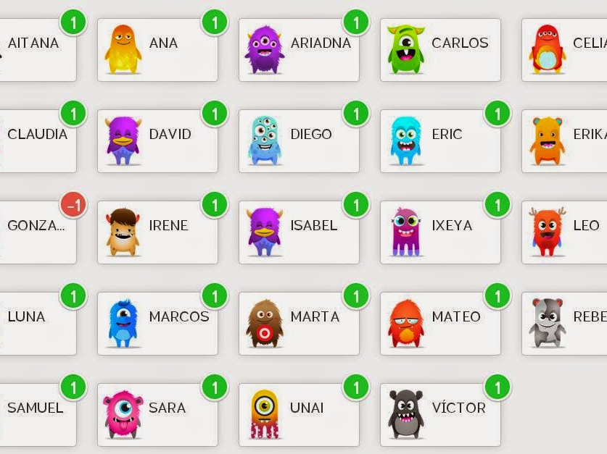
Class Dojo
Next week you will receive a paper with all the instructions on how to connect to Class Dojo.
This Photo by Unknown Author is licensed under CC BY-NC-ND

Slide 18

We are a PBIS school
This Photo by Unknown Author is licensed under CC BY-SA

Slide 19
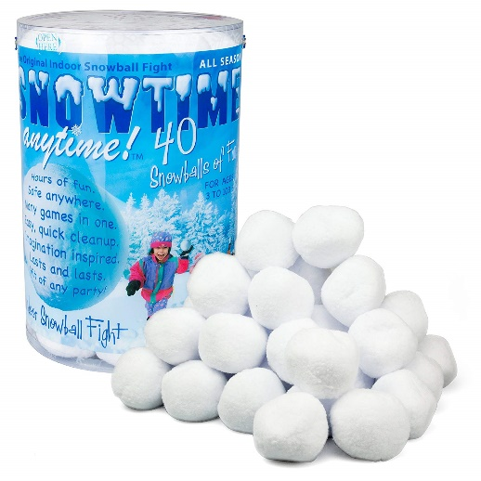
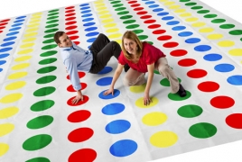

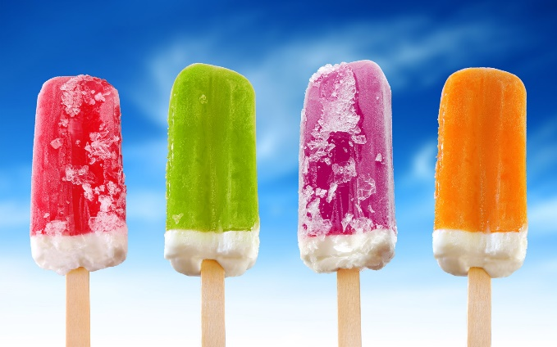
PBIS REWARDS
Th

Slide 20

Our Theme : Kid You’ll Move Mountains
This Photo by Unknown Author is licensed under CC BY-NC-ND

Slide 21
More information about math, reading, social studies and science, etc. can be found on the class and district websites.
(Also see homework folder with disclosure statement).

Slide 22
Donations
We are in constant need of supplies including Kleenex, baby wipes, pencils, small, inexpensive incentives for the treasure box, Clorox wipes, etc. Any donations you would like to make anytime during the year would be GREATLY appreciated!

Slide 23
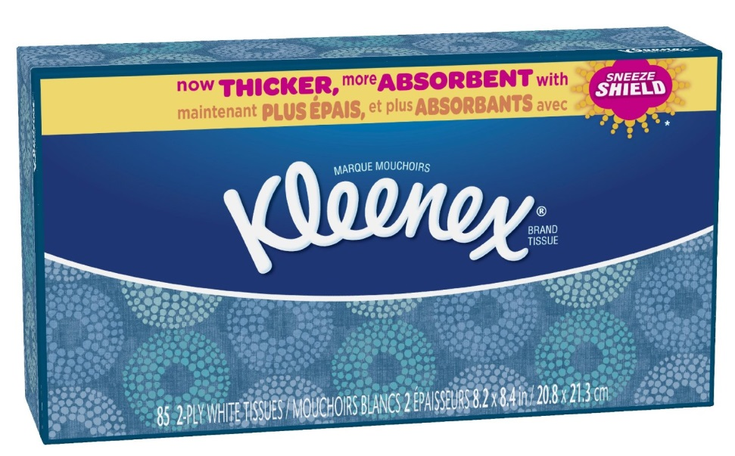
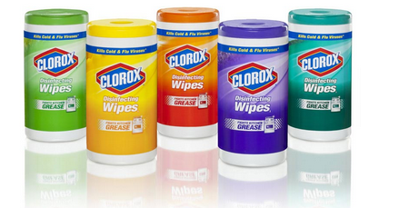
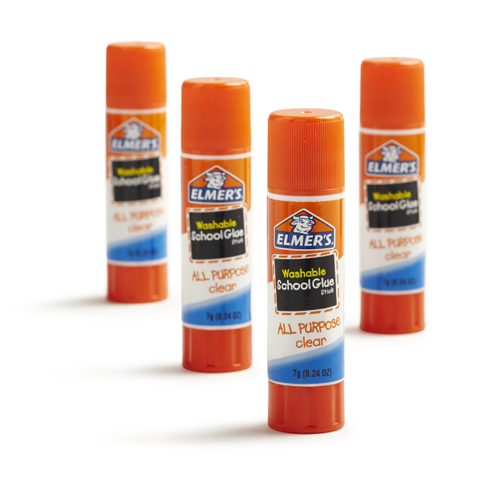
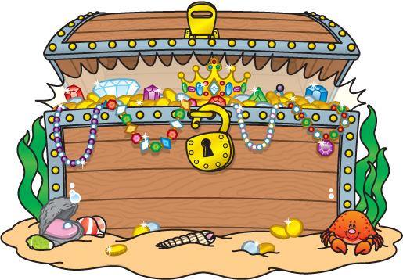
ALWAYS NEEDED!!
CC BY-NC-ND

Slide 24
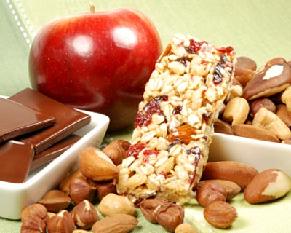
Snacks
This Photo by Unknown Author is licensed under CC BY-NC-ND
We have time on most days after before or after 1st recess to have a snack in class. If your child would like to bring a healthy snack things like fruit, nuts (if not allergic), juice, crackers, etc. are best.

Slide 25
Mrs. Darby’s Wish List
If you would like to donate any of the below items please take a FROG that is posted outside my door. Remember this is Voluntary but every little bit helps!
I NEED A ROOM PARENT!

Slide 26
Thank you for the opportunity to teach your student! I’m excited to get to meet them. Please e-mail or call ANYTIME if you have any questions or concerns: cdarby@graniteschools.org
Or . . . . .Shoot me a message on Class Dojo and I will get it immediately

